Slide 1


by ALBERT RANDO
PRESS START TO CONTINUE
Notes:
Present yourself and the topic of your presentation.

Slide 2
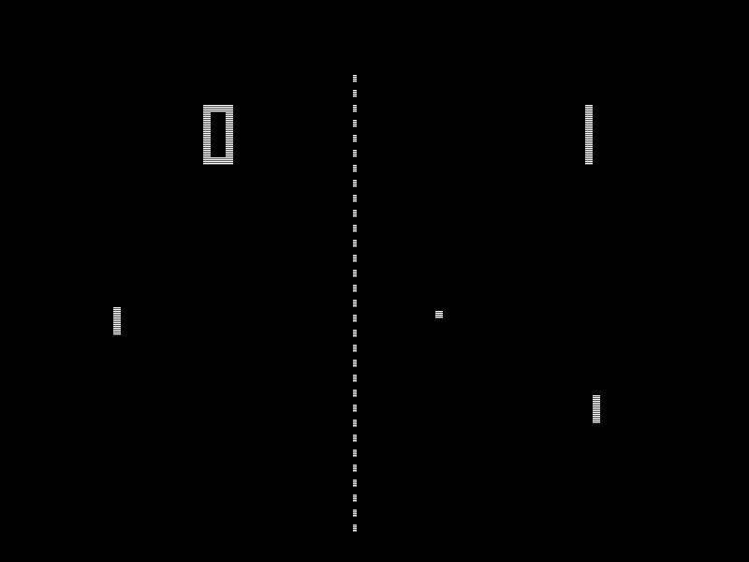
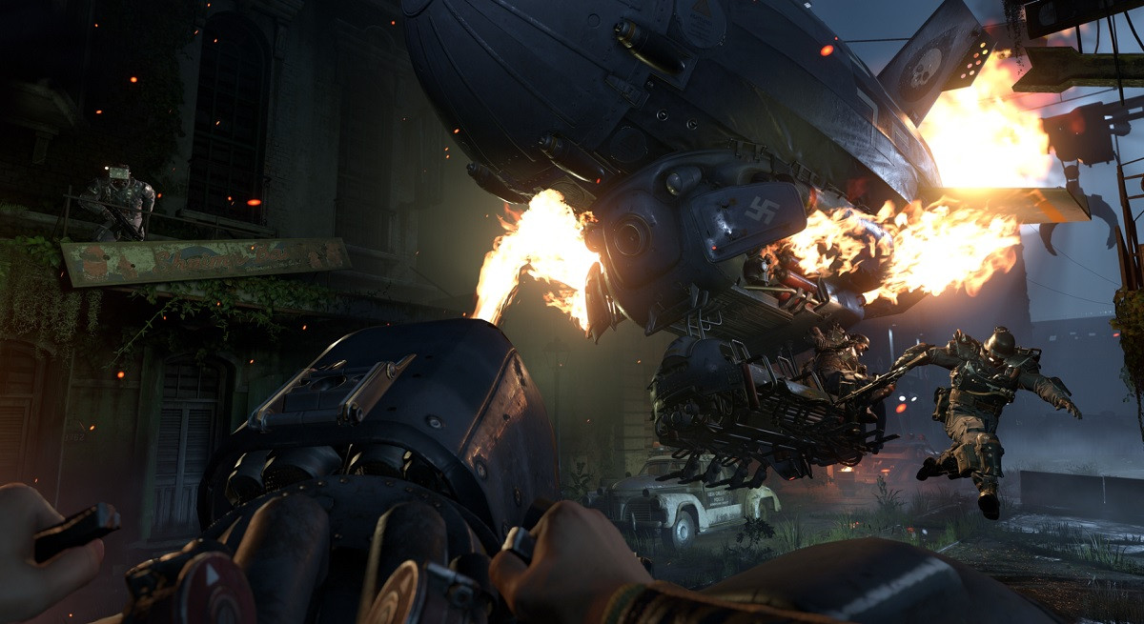
VIDEOGAMES AND AI
Pong – Atari (1972)
Wolfenstein II: The New Colossus (2017)
Notes:
BRIEF STORY OF VIDEOGAMES AND WHY AI IS SO CLOSELY RELATED.
SHOW A COUPLE PICTURES TO SHOW THE DIFFERENCE BETWEEN GAMES THEN AND GAMES NOW.
Since the birth of the videogames, as early as the 1950’s until today, the video game industry changed drastically. From the early arcades that popularized videogames until the latest videogames released today, more and more technical advanced allowed video game to grow in size and scope allowing developers today to create what a few years ago seemed impossible. Better graphics, better performances (sometimes) and of course better AI. The gaming industry generates today a revenue of over 212 billion dollars a year, and rises every year.
As we have seen and heard the idea of AI is not new either, brought by Alan Turing and coined in the Dartmouth Conference AI has come a long way since the 50’s often hand in hand with video games.
Video games provide a perfect setting for Artificial Intelligence due to the fact that it is a controlled environment with a set of programmed rules that a computer can understand and can be used to test and develop AI models.

Slide 3
Practical Applications
Pathfinding
Behaviour
Notes:
How and Where does AI apply to video games?

Slide 4
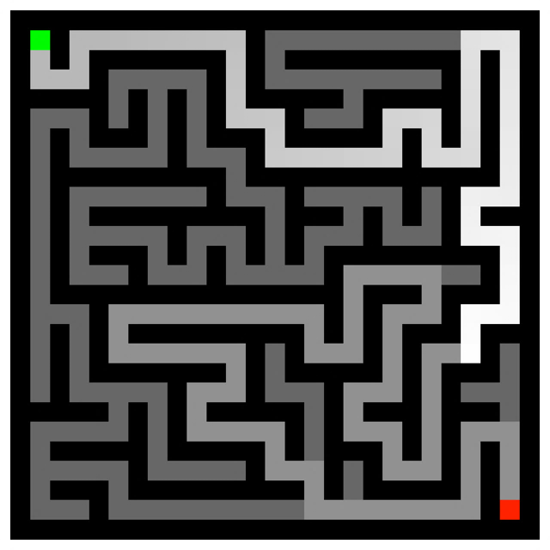
PATHFINDING
Notes:
WHAT IS PATHFINDING?
Pathfinding is a technique or a process carried by a software running in a computer from which the shortest path or route between two points is extrapolated. Pathfinding is not only important in video games, but also in other areas such as delivery, transport services and intelligent storage among others.

Slide 5
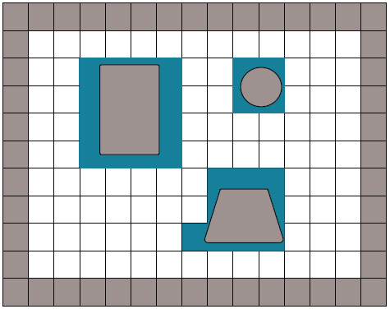
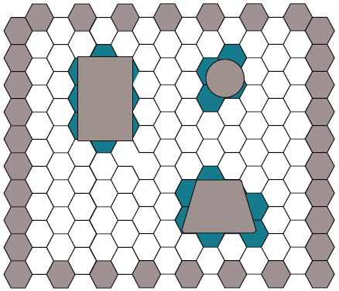
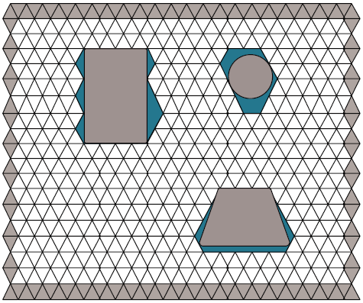
Grids
Notes:
Explain how the grid system works.
A grid is composed of vertices or points that are connected by edges to represent a graph. In most pathfinding algorithms, the navigation performance is based on the attributes of this graph representation.
Regular Grids. Regular grids are one of the most well known graph types and are widely used by computer games developers and roboticists. There are a number of video game developers who have worked in this area, producing games such as Dawn of War 1 and 2, Civilization V, and Company of Heroes; roboticists have employed regular grids in the mars rovers spirit and opportunity. In 2D and 3D environments, regular grids describe tessellations of regular polygons (i.e., equilateral and equiangular polygons). Hexagons, squares, and triangles are the only regular polygons that can be used to tessellate continuous 2D environments.

Slide 6
Pathfinding Algorithms
Dijkstra’s Algorithm and A* Algorithm
How does Dijkstra’s Algorithm work?
And what about the
A* Algorithm?
How does Dijkstra’s Algorithm work
In an actual game?
Notes:
EXPLAIN A* ALGORITHM AND DIJKSTRA ALGORITHM
https://en.wikipedia.org/wiki/Pathfinding
Dijkstra Algorithm was conceived by computer scientist Edsger W. Dijkstra in 1956. It is closely related to the shortest path problem. It uses a weighted graph to find the shortest path between two nodes. Starting from node 1 it visits every edge coming out of it and assigns to the next node the cost of getting there, and then it does the same with every other node until it finds the path with the lower cost from node 1 to node N.
A* Algorithm is a variation of Dijkstra’s Algorithm but it discards every path whose cost is higher to avoid spending resources visiting inviable or longer paths.

Slide 7
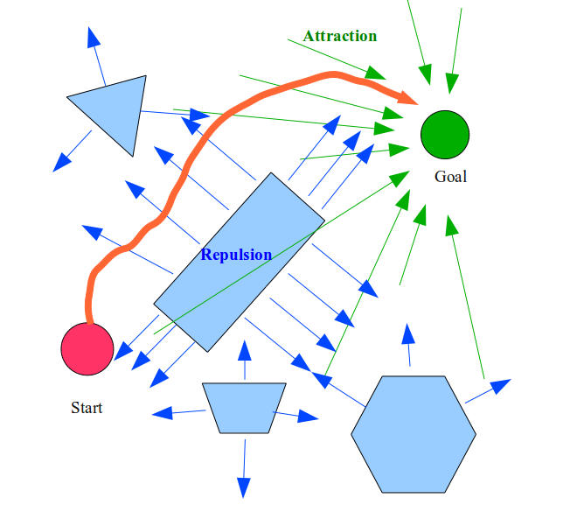
Using Potential Fields
Notes:
Explain how robotics and AI can use potential fields for pathfinding.

Slide 8
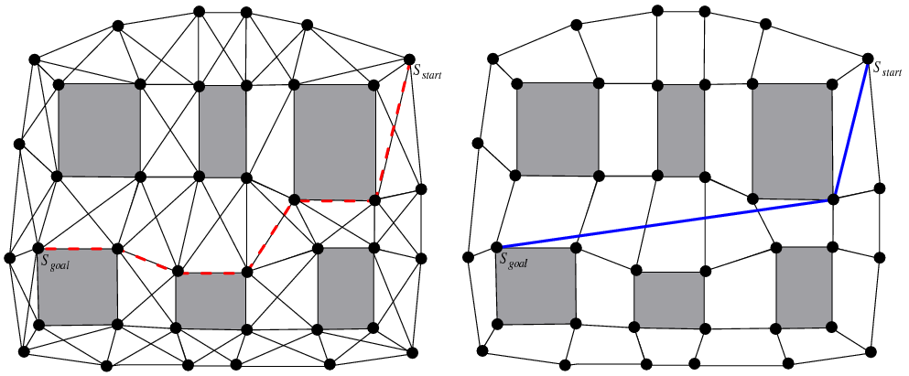
Aesthetics in Pathfinding
Notes:
http://aigamedev.com/open/tutorials/theta-star-any-angle-paths/
Talk about how

Slide 9
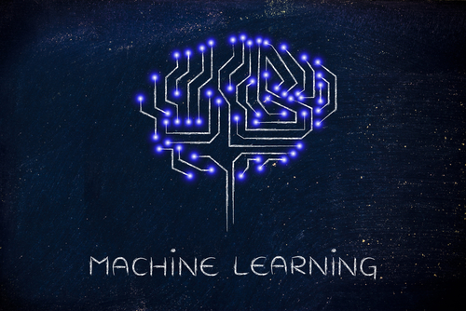
MACHINE LEARNING
Notes:
We know already how to move, now is time to talk about behaviour more in depth.
It is really necessary to implement machine learning?

Slide 10
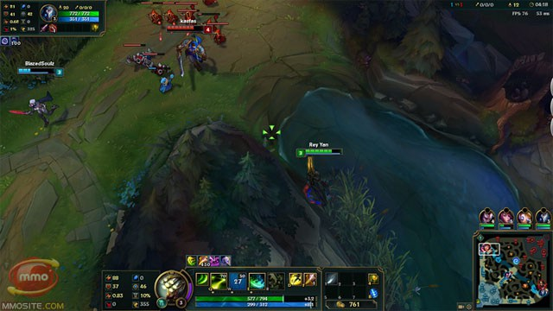
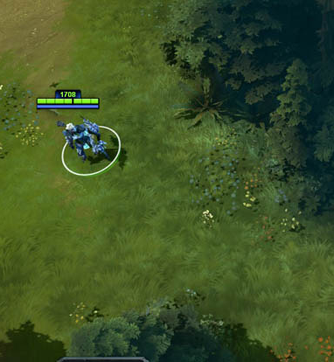
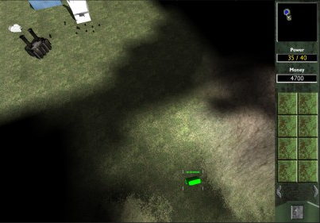
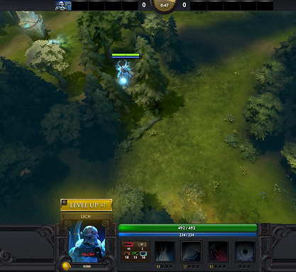
Perfect versus Imperfect Knowledge
The notion of Fog of War
Notes:
Explain the concept of perfect and imperfect knowledge.

Slide 11
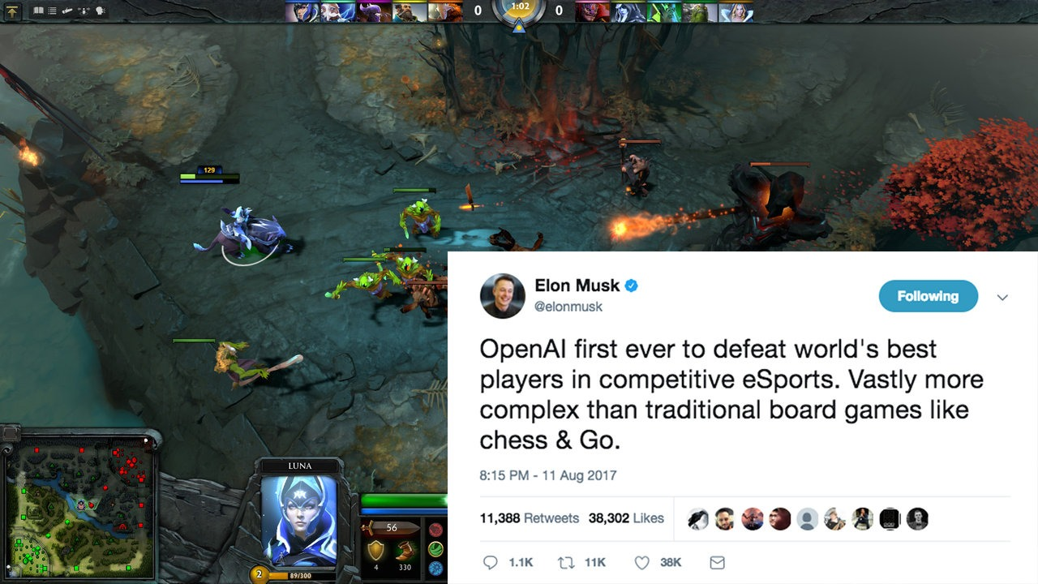
Defining Behaviour with AI
Notes:
Explain how to use machine learning to improve behaviour of NPCs.
Maybe mention DOTA 2 bot. Open AI DOTA 2 bot.
- https://blog.openai.com/dota-2/

Slide 12
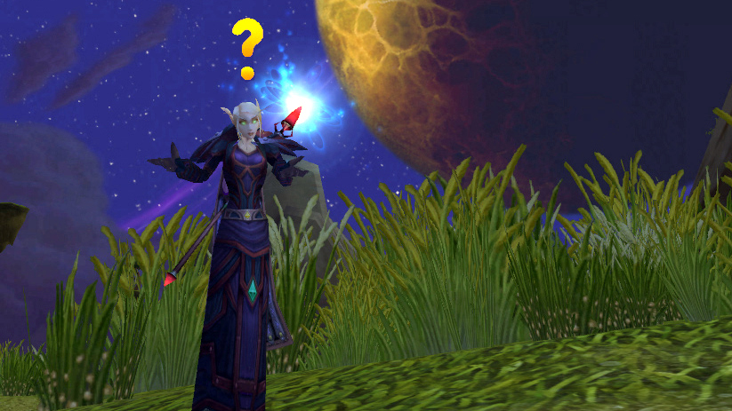
QUESTIONS ?

